Slide 1
Polychlorotrifluoroethylene (PCTFE) Polymer Enclosure for an Implantable Device
Neuralink, US 2023/0154809 A1, Published 5/18/2023
6/18/2024

Slide 2
Background
Implantable devices in-vivo have rigid hermetic housing to protect active electronics from environmental and mechanical stress
Increasingly common for large number (e.g., thousands) of tightly-spaced wires extending from implantable device
Traditional housing materials can become problematic with above structure (e.g., cracked glass housing)

Slide 3
Outline
Goal: Describe a polychlorotrifluoroethylene (PCTFE) polymer enclosure with tightly spaced wires extending out of it
Describe PCTFE + Why It’s Used
Embodiments:
Implantable Device with PCTFE Enclosure + Exploded View
5 Views of a PCTFE Enclosure with Insulated Wires
Sealing System for Manufacturing a PCTFE Enclosure
2 Views of an Insert of a Sealing System for Manufacturing a PCTFE Enclosure
Sealing System in Operation for Manufacturing a PCTFE Enclosure
Controller for Use with the Sealing System
Flowchart for Manufacturing Implantable Device
Computer System

Slide 4


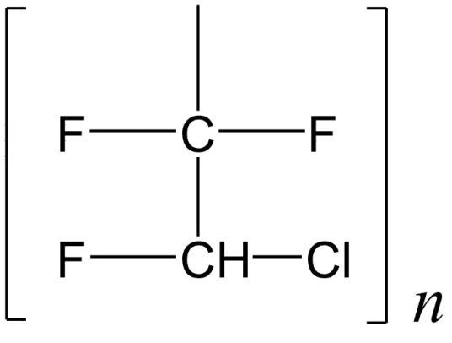
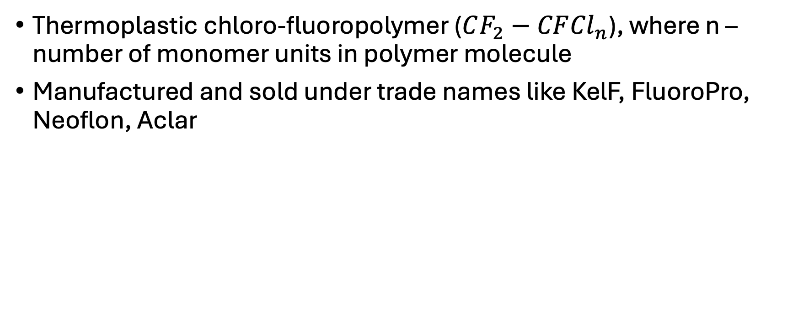
What is PCTFE?
Thermoplastic chloro-fluoropolymer ($CF_{2}−CF{Cl}_{n}$), where n – number of monomer units in polymer molecule
Manufactured and sold under trade names like KelF, FluoroPro, Neoflon, Aclar

Slide 5
Why PCTFE?
Chemical properties:
Good resistance to chemical attack and oxidizing agents – high fluorene content, lack of hydrogen atoms
Physical properties:
Good rigidity to prevent mechanical stress on implantable device
Low dielectric constant for Bluetooth Low Energy (BLE) communication and wireless charging
Barrier properties:
Close to zero water absorption (<0.01%)
Good for substantially hermetic enclosure (completely prevent passage of fluids/gases for tens of years)
Low water vapor permeability
Highest gas barrier property with WVTR (0.005g/m2/24 hr) at 25C
Mechanical properties:
High tensile strength
Moderate hardness
Thermal properties:
Melting point: 212C
Maximum temperature for continuous use: 120C
Glass transition temperature: 45C
Good melt flow properties with excellent stress crack resistance

Slide 6
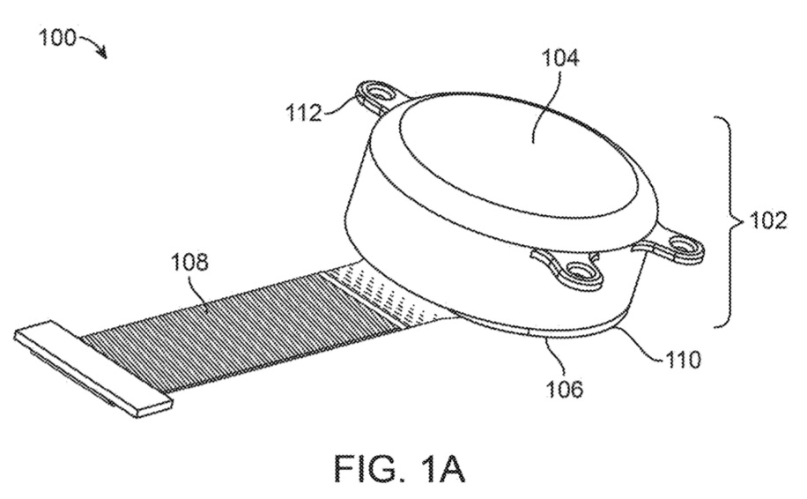


Implantable Device with PCTFE Enclosure
Screws: 1.8mm diameter
Screw
hole:
1.8-1.9
mm
First PCTFE portion
Attachment Means
(holds implantable device in place near skull of subject)
Insulated Wires
(at least 500, parallel)
PCTFE Enclosure
Welded Seam
(seals 2 PCTFE portions)
Second PCTFE portion

Slide 7
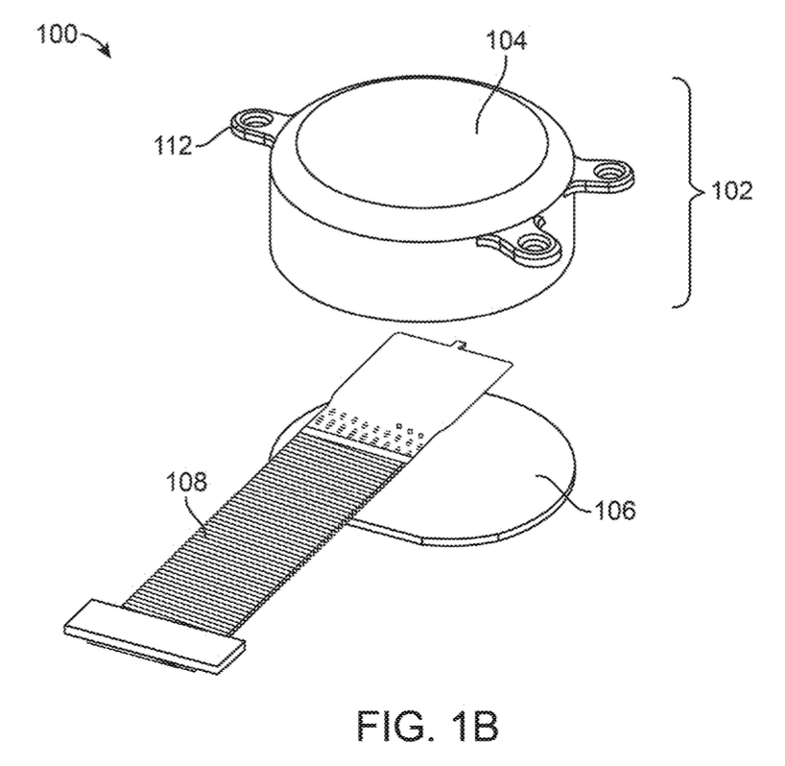
Exploded view of Implantable Device
First portion
Attachment Means
PCTFE Enclosure
Insulated Wires
Second portion

Slide 8
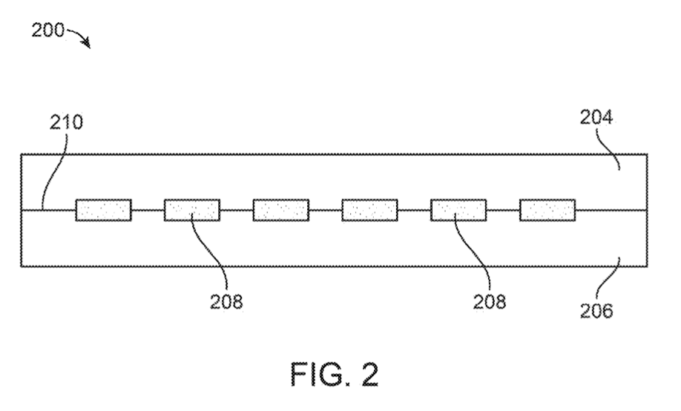
Close-up Cross-sectional View of a PCTFE Enclosure with Insulated Wires
Welded Seam
(adheres around insulation of wires if PCTFE portions hermetically sealed)
First PCTFE portion
Insulated Wires
- Composed of polymide (PI)
- Thin and long -
Width 5-50 micrometers,
Nominal thickness 4-6 micrometers,
Length about 20mm
- Produced by lithography
Second PCTFE portion

Slide 9
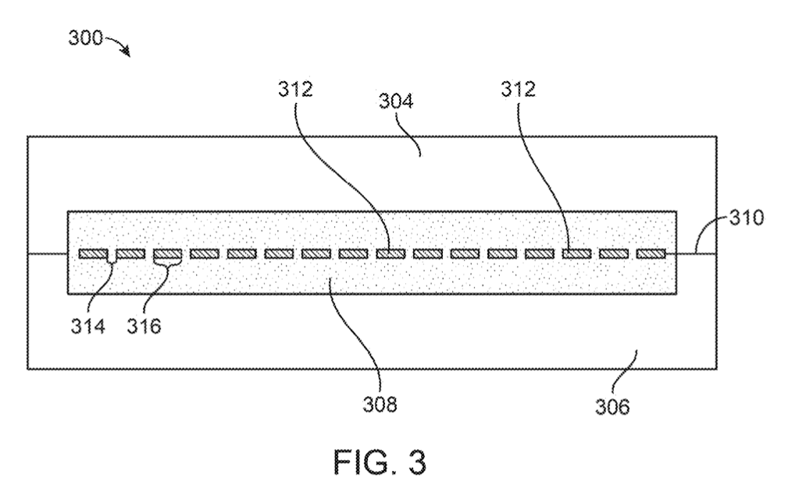

Close-up Cross-sectional View of a PCTFE Enclosure with Insulated Wires
Metal trace
Individual, metallic threads within insulation
Include metals/metal alloys (e.g., thin gold film)
May include 16 traces
Terminates in electrode
First PCTFE portion
Welded Seam
Distance between metal traces
(2 micrometers)
Cross-sectional width of metal trace
(2 micrometers)
Insulated Wire
Second PCTFE portion

Slide 10
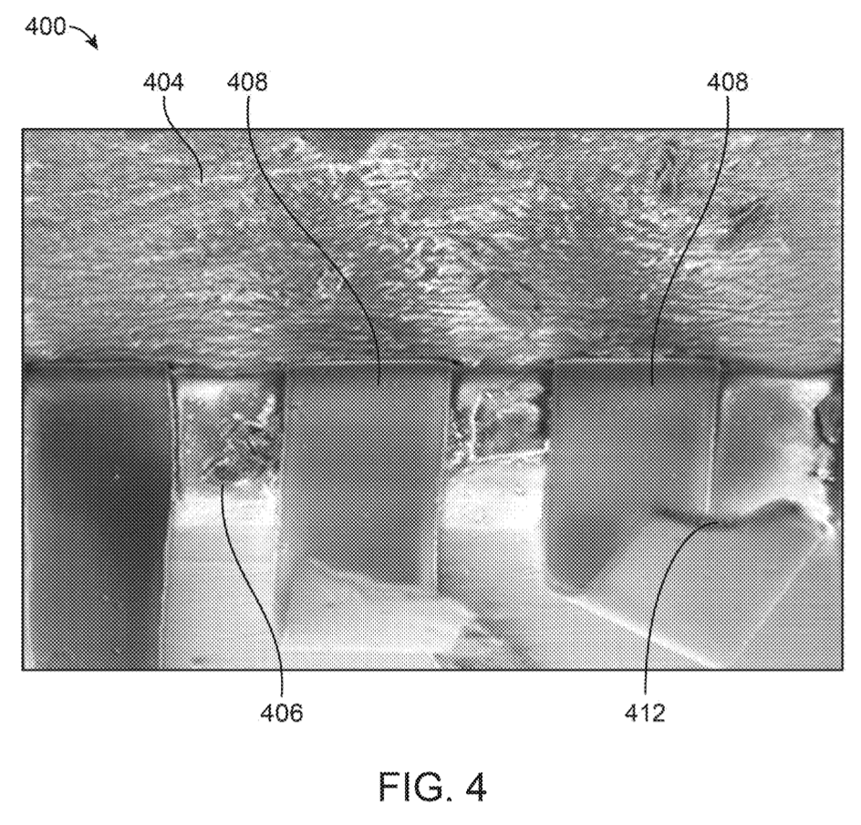
Closer View of a PCTFE Enclosure with Insulated Wires
First PCTFE portion
Insulated Wire
Second PCTFE portion
Metal Traces

Slide 11
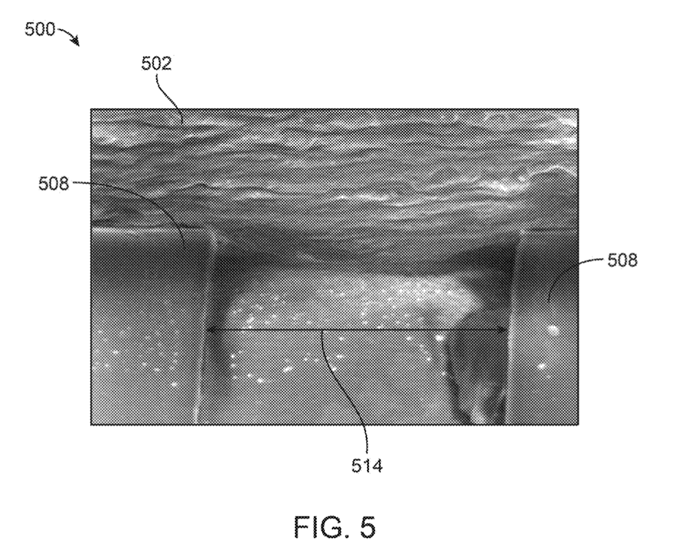
View of a PCTFE Enclosure with Insulated Wires
PCTFE Enclosure
Insulated Wire
Distance
(less than 150 micrometers)

Slide 12
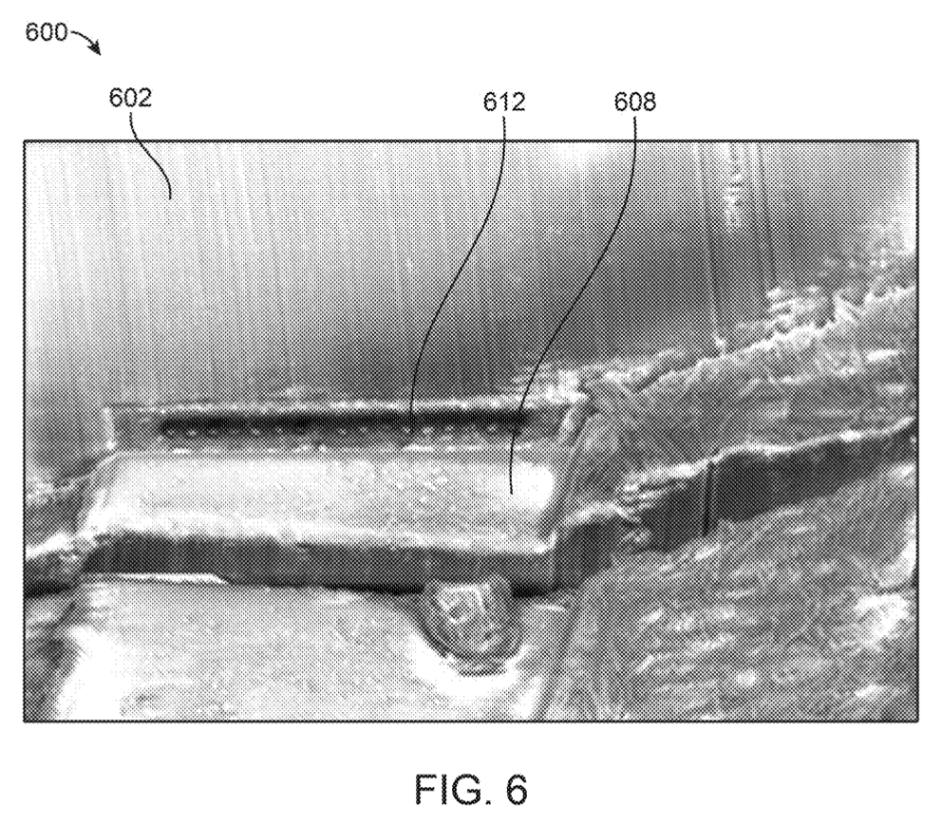
(Even Closer) View of a PCTFE Enclosure with Insulated Wires
PCTFE Enclosure
Metal Traces
Insulated Wire

Slide 13
Figs 1-6 Manufactured via Sealing System
Figs 1-6 manufactured via sealing system
Next figures will describe sealing system + process

Slide 14
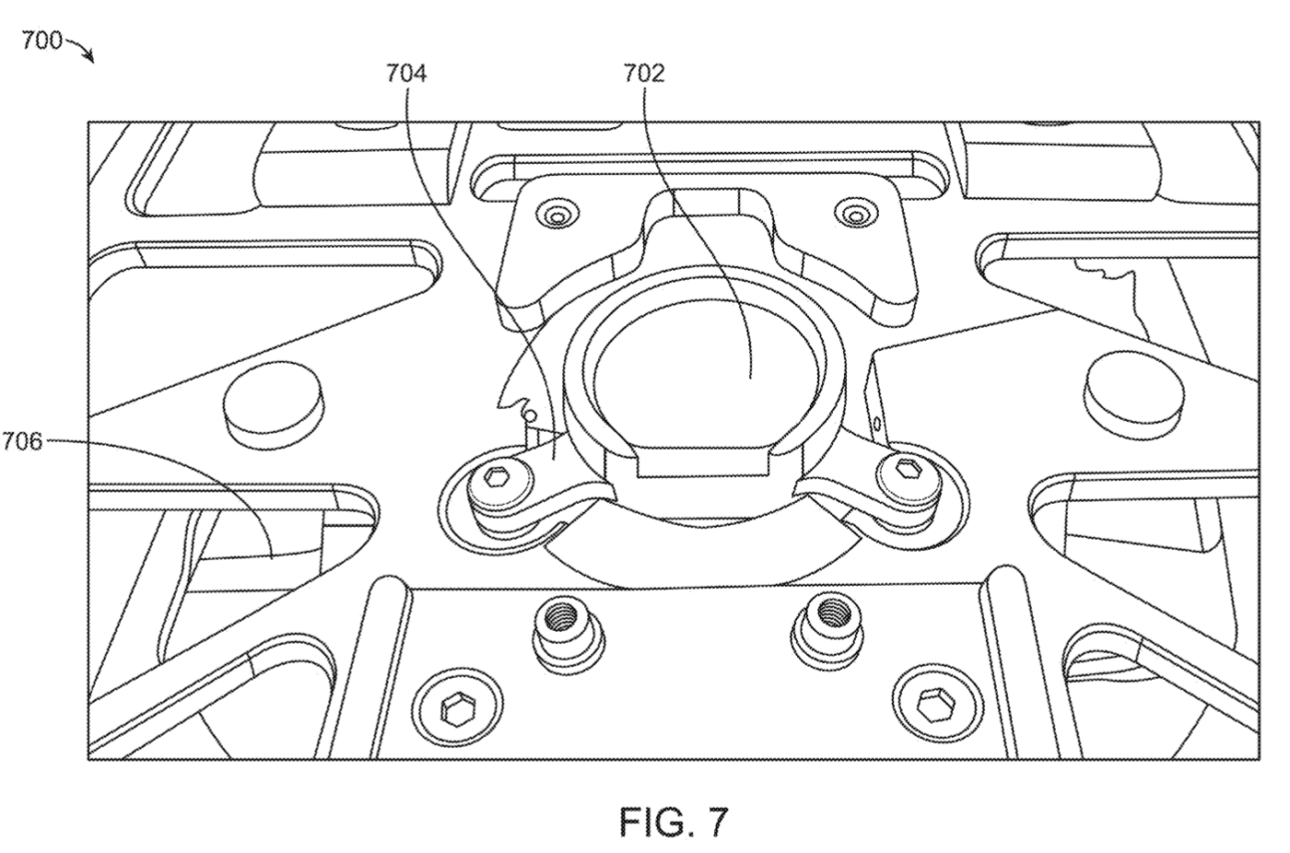
Sealing System for Manufacturing a PCTFE Enclosure
Base
Hold PCTFE enclosure
Opening
Heater
Apply heat to PCTFE enclosure

Slide 15
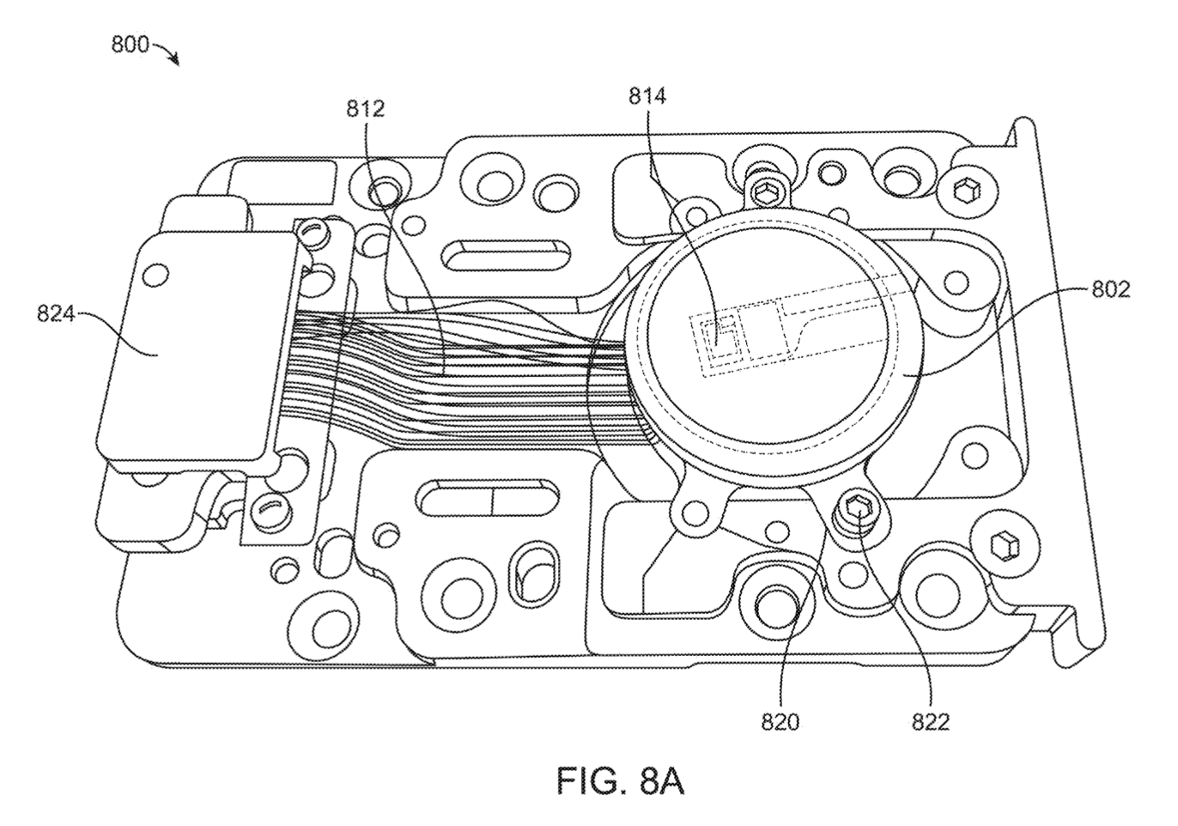
First View of an Insert of a Sealing System for Manufacturing a PCTFE Enclosure
Insert
Holds wires and PCTFE enclosure in place during sealing
Circuitry
Wires
PCTFE Enclosure
Clamp
Attachment means
Screws

Slide 16
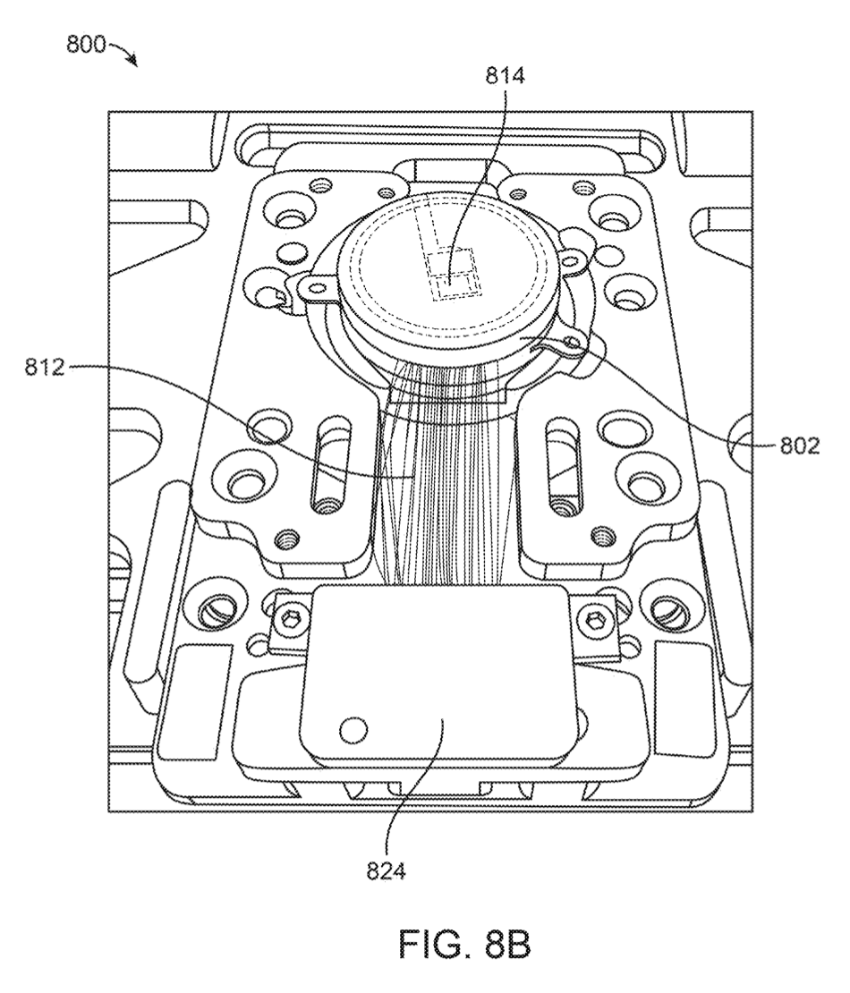
Second View of an Insert of a Sealing System for Manufacturing a PCTFE Enclosure
Circuitry
Wires
PCTFE Enclosure
Clamp

Slide 17
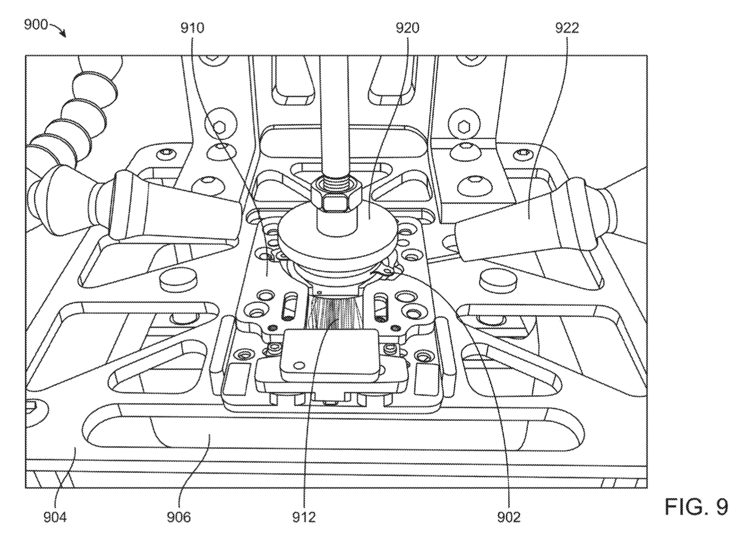
Sealing System in Operation for Manufacturing a PCTFE Enclosure
Pistons
- Apply pressure to PCTFE enclosure via hydraulic/pneumatic cylinders
- Includes 2 pistons (one above base, one below base)
Air Nozzles
Apply air to enclosure during/after sealing process (e.g., cool enclosures after sealing, cool enclosure to keep temperature reasonable during sealing)
PCTFE melts and reflow around insulated wires for sealing under appropriate temperatures
Insert
Base
Heater
Insulated Wires
PCTFE Enclosure

Slide 18
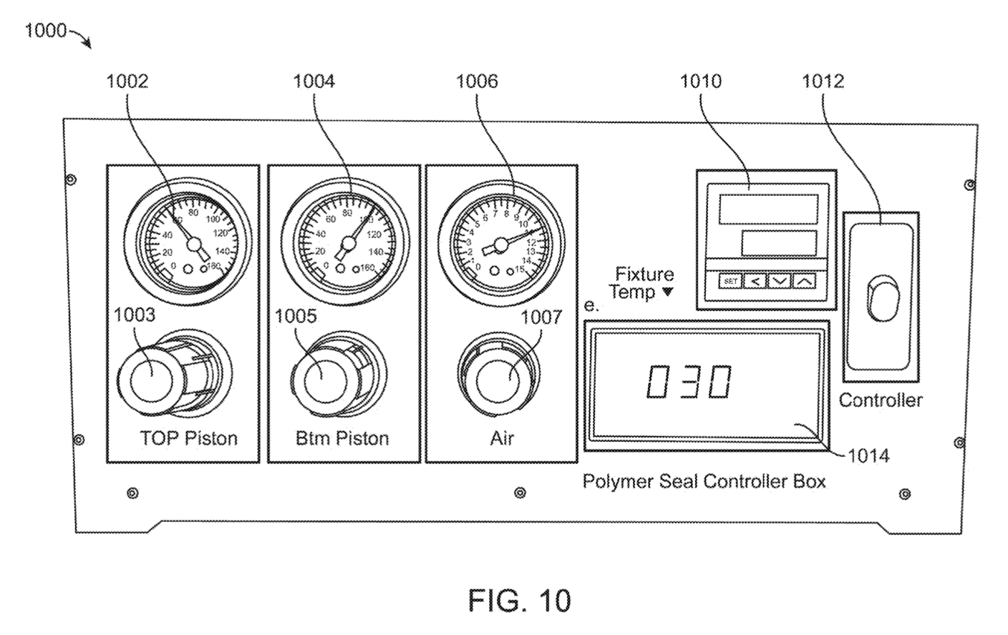
Controller for Use with the Sealing System
Pressure gauge for bottom piston
Controller:
Automatically controls sealing process
Pressure gauge for top piston
Pressure gauge for air
Temperature Controls
Power button
Dial
Display
(shows current temperature)

Slide 19
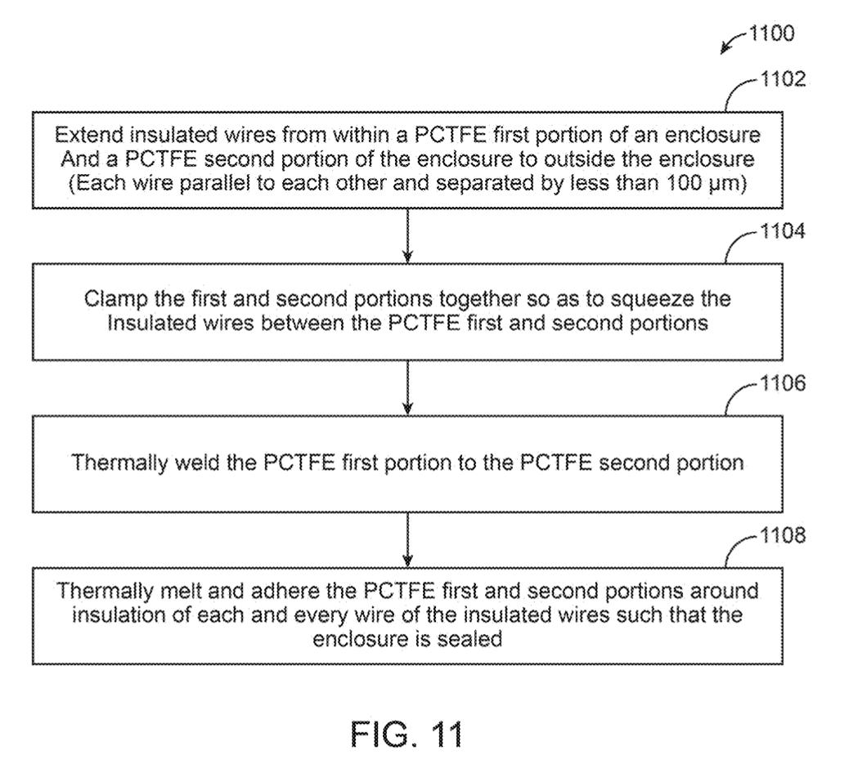
Flowchart for Manufacturing Implantable Device
Sealing process: May be partially or completely automated!

Slide 20
Step 1:
Wires
Circuitry
PCTFE Enclosure
Clamp
Attachment means
Screws

Slide 21
Step 2:
Insert
Pistons
Air Nozzles
Pressure applied to first piston: 40 – 80 psi
Pressure applied to second piston: > 100 psi
Base
Heater
Insulated Wires
PCTFE Enclosure

Slide 22
Step 3:
Base
Opening
Heater heats PCTFE to at least 200C to melt PCTFE for the sealing process
Pressure applied to the heating for the thermocompression molding process
Heater

Slide 23
Step 4:
1. Thermally melt 1st and 2nd PCTFE portions & adhere around insulation of each wire to seal enclosure
PCTFE melts and reflows around wires
Polymer + insulation – forms a seal around wire
Heat PCTFE to 200-300C
Must set upper limit temperature (e.g., 255-260C) to avoid melting other components
2. Cool Implantable Device
Sealing system transitions to cooling mode
Notify user (e.g., alarm) when cooling complete
User detatches implantable device from sealing system (e.g, via clamps, unscrewing, etc.)

Slide 24
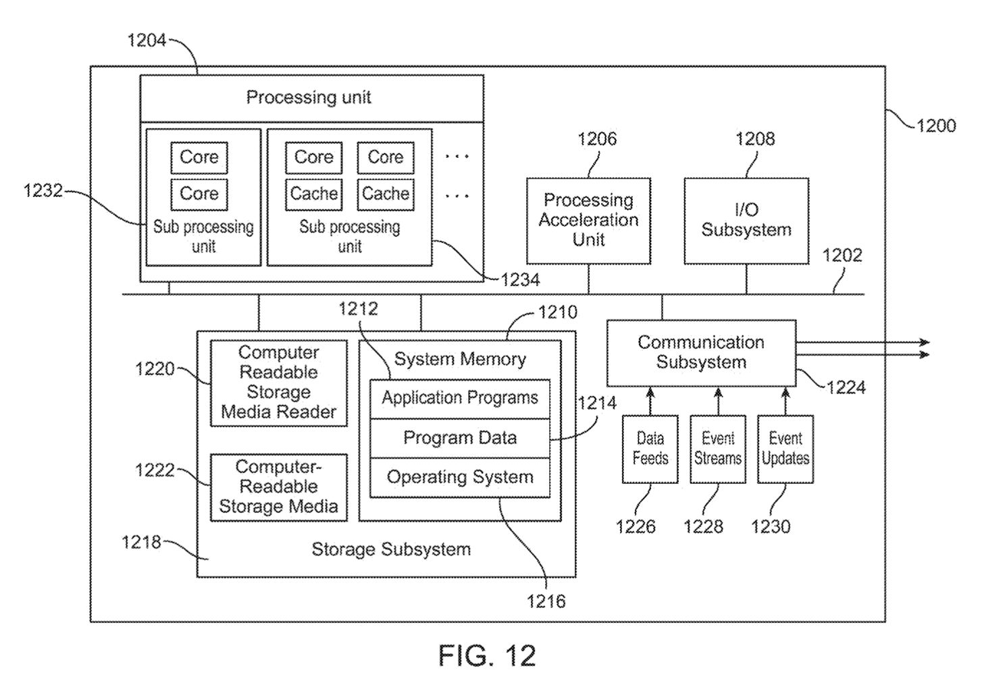
Computer System

